Slide 1
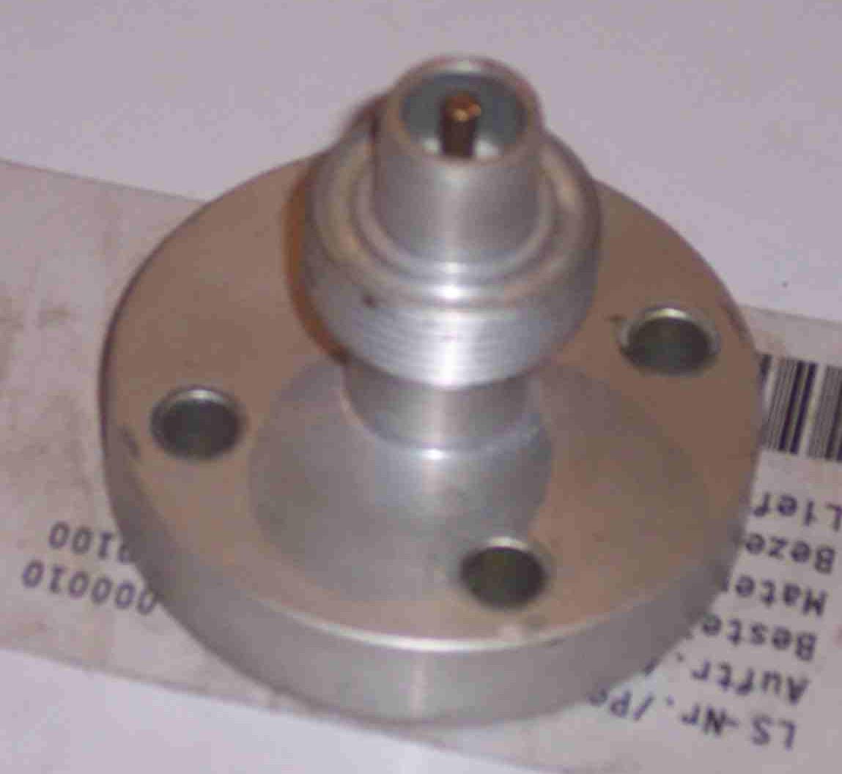
SIEMENS
HVCB SPARES
NRV for gas inlet
72.5KV,145KV & 245KV CB
S4712828001

